Slide 3
CHAPTER ONE
Confidence, Monetary Policy, and Fiscal Policy
Different Ways to View The Economy
Three Pillars of Macroeconomics
Gross Domestic Product (GPD)

Slide 4
Macroeconomics and microeconomics are two different ways to view the economy.
CHAPTER ONE
Confidence, Monetary Policy, and Fiscal Policy
Different Ways to View The Economy
Three Pillars of Macroeconomics
Gross Domestic Product (GDP)
Macroeconomics
Views the economy as a whole
Focus on aggregate changes in unemployment, growth, and inflation
Microeconomics
Focus on specific markets or industries
Study of individuals, firms, and market behavior with regards to decision making and allocation of resources
4
Copyright © Money, Banking and Financial Markets

Slide 5
Three Pillars of Macroeconomics
CHAPTER ONE
Confidence, Monetary Policy, and Fiscal Policy
Different Ways to View The Economy
Three Pillars of Macroeconomics
Gross Domestic Product (GDP)
The three pillars work together to form the bedrock of the national economy.
They unite together to:
Optimize economic growth
Stabilize inflation
Fight unemployment
5
Copyright © Money, Banking and Financial Markets

Slide 6
Three Pillars of Macroeconomics
CHAPTER ONE
Confidence, Monetary Policy, and Fiscal Policy
Different Ways to View The Economy
Three Pillars of Macroeconomics
Gross Domestic Product (GDP)
Confidence
The most important of the three pillars
Sets the tone for the economy
Fuels business innovation and the economy
Economic confidence is crucial when facing economic adversity
6
Copyright © Money, Banking and Financial Markets

Slide 7
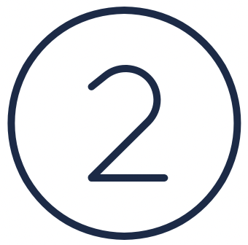
Three Pillars of Macroeconomics
CHAPTER ONE
Confidence, Monetary Policy, and Fiscal Policy
Different Ways to View The Economy
Three Pillars of Macroeconomics
Gross Domestic Product (GDP)
Confidence
The process of adjusting the supply of money, the availability of credit, and the cost of borrowing
Federal Reserve Bank implements policy
Creating balance in the economy
Actions that stimulate economic activity
Actions that slow economic growth
Monetary Policy
7
Copyright © Money, Banking and Financial Markets

Slide 8
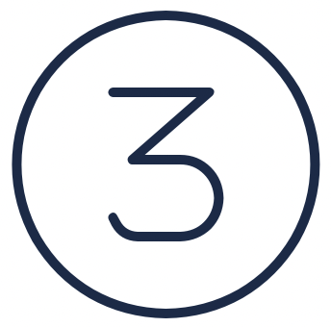
Three Pillars of Macroeconomics
CHAPTER ONE
Confidence, Monetary Policy, and Fiscal Policy
Different Ways to View The Economy
Three Pillars of Macroeconomics
Gross Domestic Product (GDP)
Confidence
The use of government spending and taxation to influence the macroeconomy
Allows government to implement changes that influence demand, inflation, and GDP
Primary Goal – control government spending levels and set tax rates (private economy)
Controlled by government and carried out by laws passed through Congress
Monetary Policy
Fiscal Policy
8
Copyright © Money, Banking and Financial Markets

Slide 9
Gross Domestic Product (GDP)
CHAPTER ONE
Confidence, Monetary Policy, and Fiscal Policy
Different Ways to View The Economy
Three Pillars of Macroeconomics
Gross Domestic Product (GDP)
Gross Domestic Product (GDP) The market value of all final goods and services produced within a country during a given time period.
GDP is the building block to understanding the economy - measures the economic health of nations
Key factors when calculating GDP:
Only newly processed goods count towards GDP
Household services are not counted as GDP
GDP often includes the imputed value of certain services
Some transactions are missed in calculation (ie. illegal transactions)
9
Copyright © Money, Banking and Financial Markets

